Slide 1
GUI for Underwater Robotics
Yasasvi Peruvemba
Ashwini Jha
Devansh shah
Amanpreet Singh
CS 258 project under
Dr. i.a. palani

Slide 2
Project Objectives
Develop a Graphic User Interface to:
Remotely switch the robot on/off.
Display the sensor data

Slide 3
Technologies Used
JavaScript
WebSockets
NodeJS
Arduino
DHT Sensors
HTML/CSS/Bootstrap

Slide 4
Arduino
Arduino is an open-source hardware and software company, project and user community that designs and manufactures single-board microcontrollers and microcontroller kits for building digital devices and interactive objects that can sense and control both physically and digitally.
Arduino is the backbone of our project as it helps in creating a switch over the internet.

Slide 5
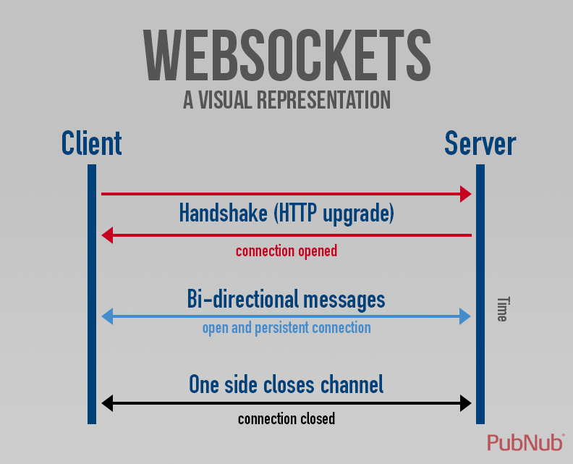
WebSockets
WebSockets provide a persistent connection between a client and server that both parties can use to start sending data at any time.
The client establishes a WebSocket connection through a process known as the WebSocket handshake. This process starts with the client sending a regular HTTP request to the server.

Slide 6
Node.JS
Node.js is an open-source, cross-platform JavaScript run-time environment that executes JavaScript code outside of a browser.
We created our web server using Node.js
Communicates with the client
Sends sensor data to the web client.

Slide 7
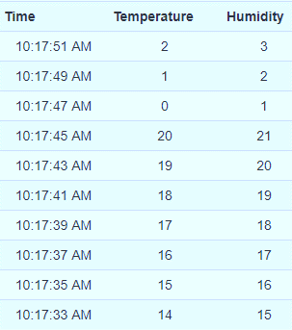
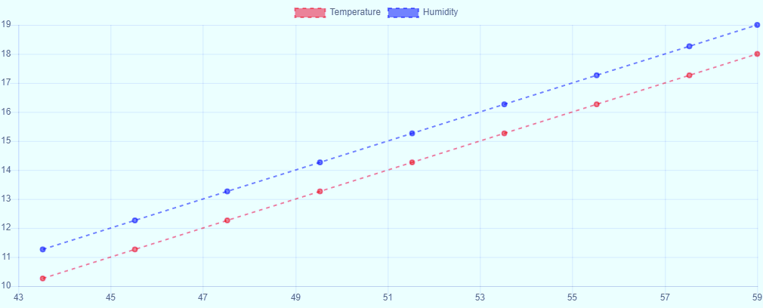
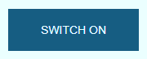
JavaScript
Bootstrap used for designing responsive webpage
JavaScript used to add features to the webpage which include:
Switch functionality of the button
Taking data from the node server and pushing into JavaScript array object.
Displaying the data in form of a graph and table.

Slide 8
GUI contents
LOGIN page
SWITCH button
Graph for Temperature SENSOR data
Graph for Humidity SENSOR data
Table for Temperature SENSOR data
Table for Humidity SENSOR data

Slide 9
Pre-Requirements
NodeJS
Command Prompt / Terminal / Git

Slide 10
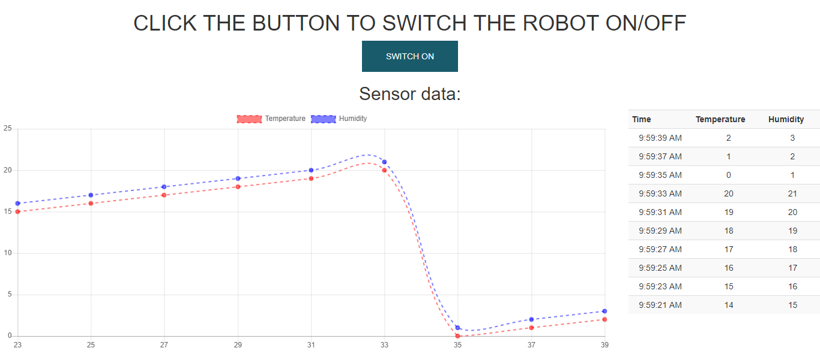
HOW TO USE?
Supply voltage to ESP8266 connected Arduino
Start Node Server
Open localhost on browser
LOGIN

Slide 11
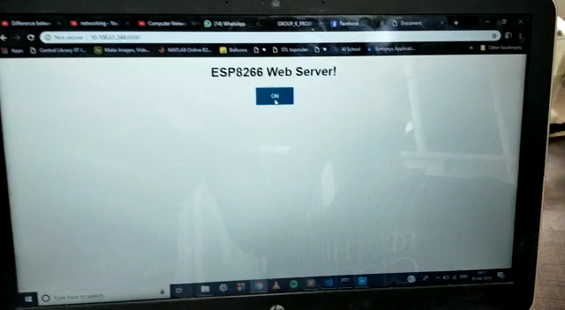

Slide 12
Future Scope
Since the robot is not yet fully developed, so there is possibility of adding many new features.
New sensors may be added to study underwater properties.
Camera may be added.
All the data from sensors and data may be displayed on the webpage.

Slide 13
THANK YOU ☺

